Slide 1
Weekly Presentation
Jiayu Chen
2023.8.14
Notes:
Ok, I will begin my weekly Presenation.

Slide 2
Work_1: Improve code: DataDemo/simscg.py
Simulation before codes are improved:
>python simscg.py 1 0 90 180 filename
Hr:110 rr:11 sp:167 dp:70
Changing only the noise level produces completely different signals.
>python simscg.py 1 0.1 90 180 filename
Hr:77 rr:16 sp:101 dp:72
Simulation after codes are improved:
>python simscg.py 1 0 90 180 seed filename
Producing the same signal is simply a matter of the absence or presence of the noise.
Hr:110 rr:11 sp:167 dp:70
>python simscg.py 1 0.1 90 180 seed filename
Hr:110 rr:11 sp:167 dp:70
New simscg.py is uploaded to https://github.com/A-Big-Tortoise/NRSR_Research/tree/main/Code/new_simscg.py
I hope that helps.
Notes:
My first work is to make some improvements for the simulation of the scg signal.
Prof song you once give us a file called DataDemo, we can use it to simulate scg signals.
It is a little inconvenient to use. So I make some improvements.
Before the codes are improved.
Changing only the noise level produces completely different signals. If I want to test the de-noising effect of the algorithm, I have to write codes to add the noise manually.
After the codes are improved.
Producing the same signal is simply a matter of the absence or presence of noise.
It is more convenient to check the de-noising effect of the algorithm.
The new code is uploaded to my github, I hope that helps.

Slide 3
Work_2: Get Envelope, HR Rate, Segmentation, Clustering
Clean Data
(No Noise, No RR)
Envelope
Hilbert Transform
Peaks Detection
HR Estimation
Segmentation
Heartbeat Rate
Stack
K-Shapes Clustering
Template
Notes:
My second work is to try use Hilbert transform to get envelope, use Heartbeat rate to segment signals and use K-shapes clustering to get the Template signal.

Slide 4
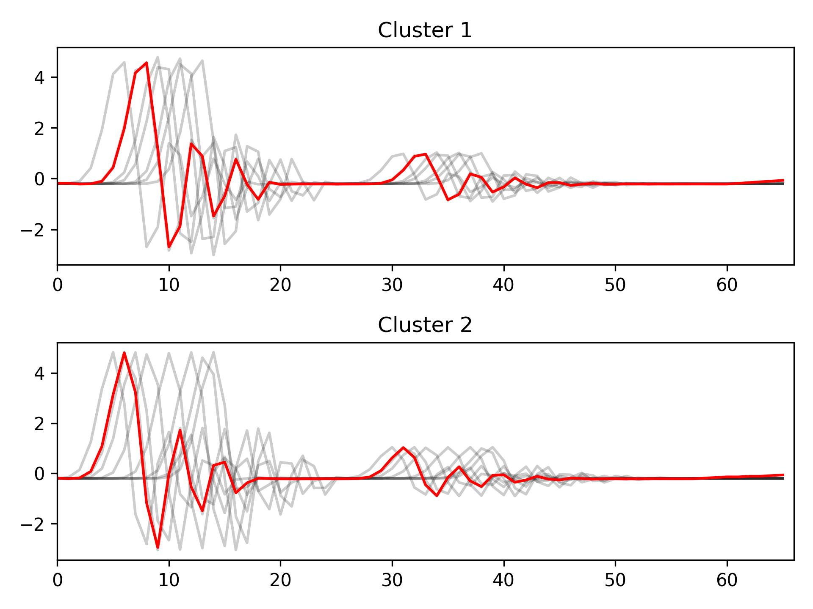
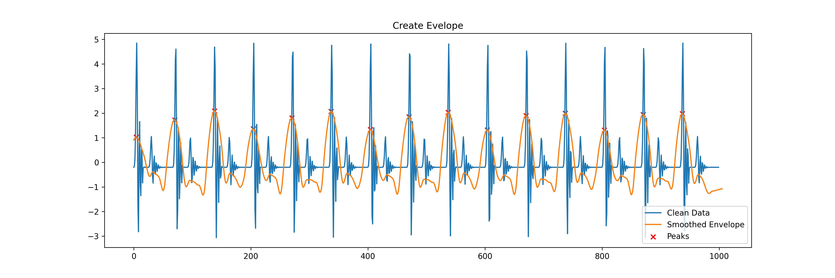
Work_2: Get Envelope, HR Rate, Segmentation, Clustering
Segmentation and Clustering
Create Envelope and Peaks Detection
After removing the noise, the envelope obtained by this method will be perfect.
Segmentation based on HR will cause each segment has different phases.
K-shapes Clustering is particularly suitable for handling this situation.
Notes:
It not hard, I just show the result.
The fist picture is about create envelope and peak detection.
We can see.
After removing the noise, the envelope obtained by this method will be perfect.
The 2nd picture is about Segmentation and clustering
Segmentation based on HR will cause each segment has different phases.
K-shapes Clustering is particularly suitable for handling this situation.
If noise Are Removed, this pipeline will work well.

Slide 5
Work_3: Implement One Paper: Band Filter, EEMD, PCA and Spectrum Analysis
Noisy Data
Band-pass Filter
EEMD / EMD
IMFs Selection
PCA
PCA
Spectrum Analysis
Spectrum Analysis
HR Estimation
RR Estimation
Notes:
Ok, the next is my third work.
I implement one paper. The idea of the paper is pretty simple.
First, the data will be passed through a Band-Pass filter,
and then the data will be decomposed using EEMD or EMD.
Then the decomposed IMFs will be selected by their frequencies.
After selection, PCA and spectral analysis will be performed to obtain the HR and RR Estimation.

Slide 6
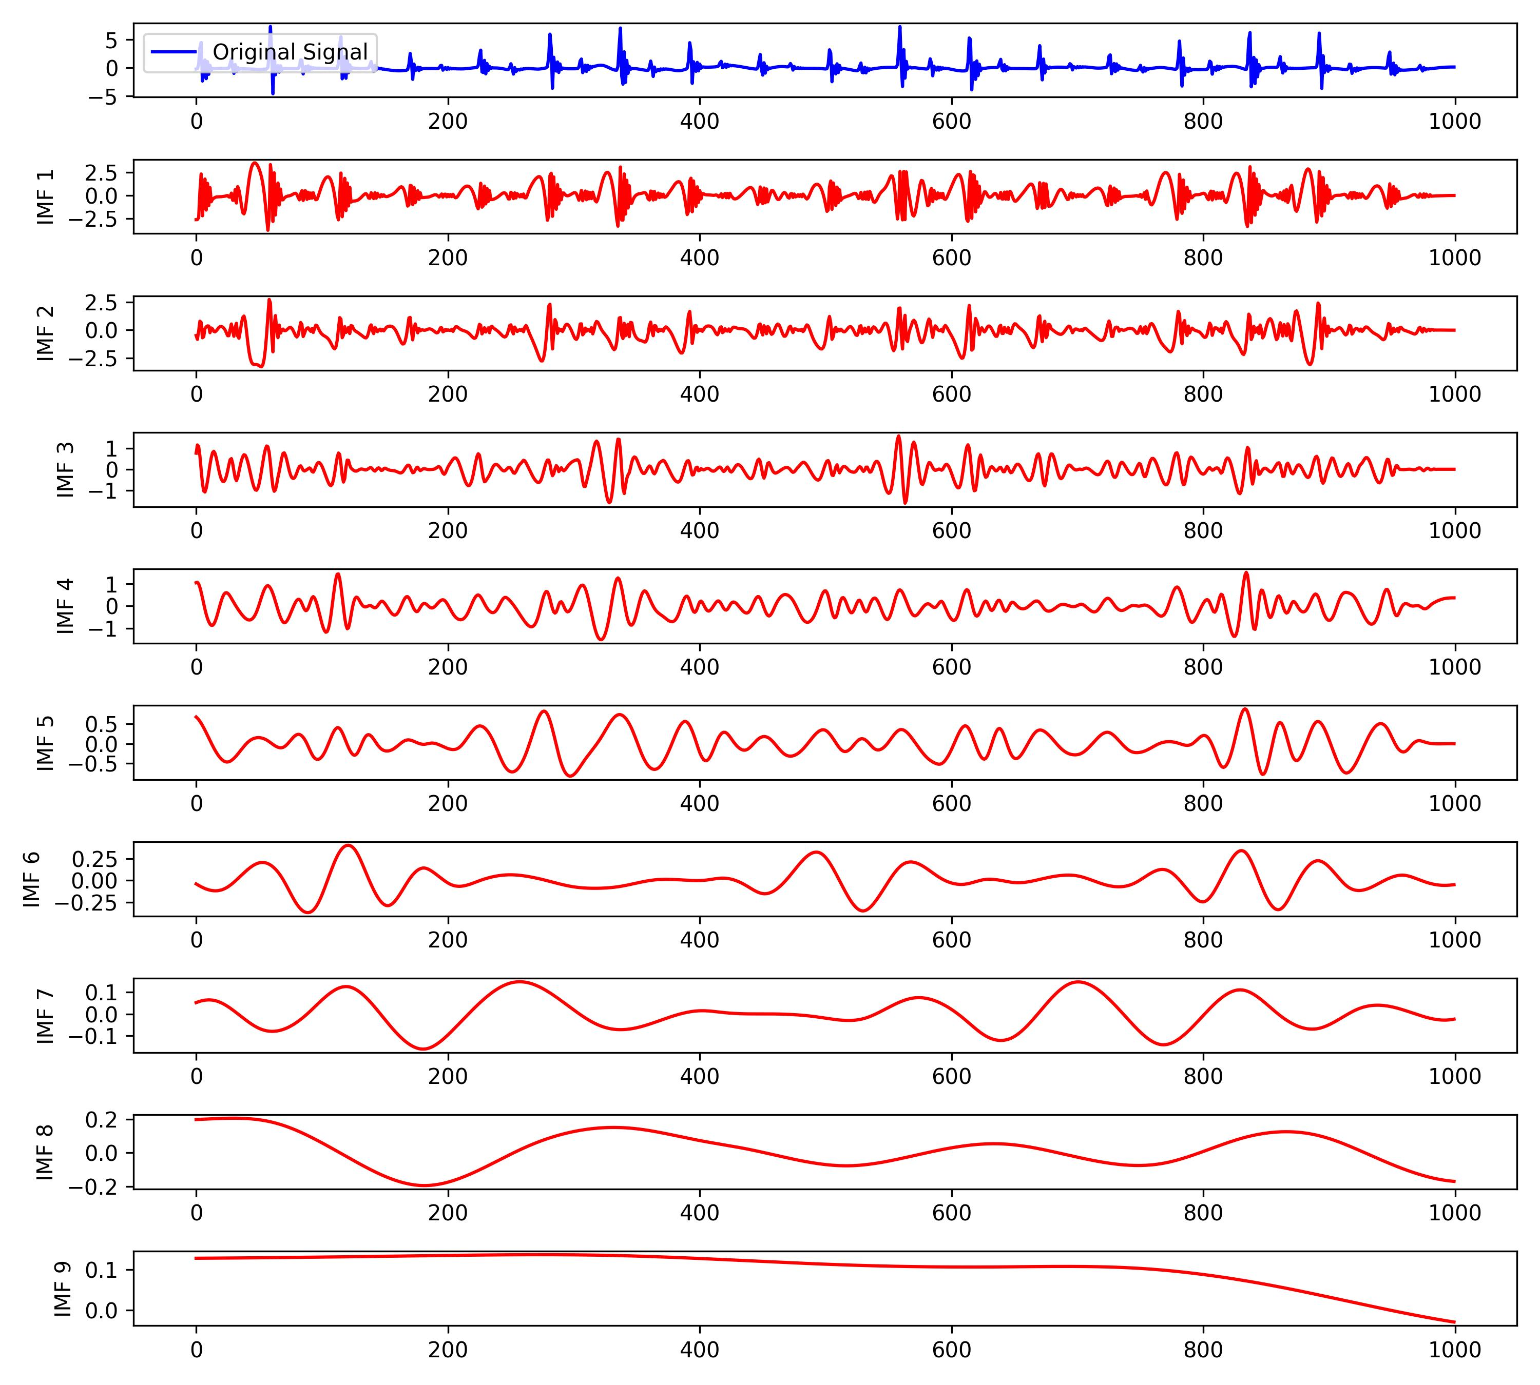
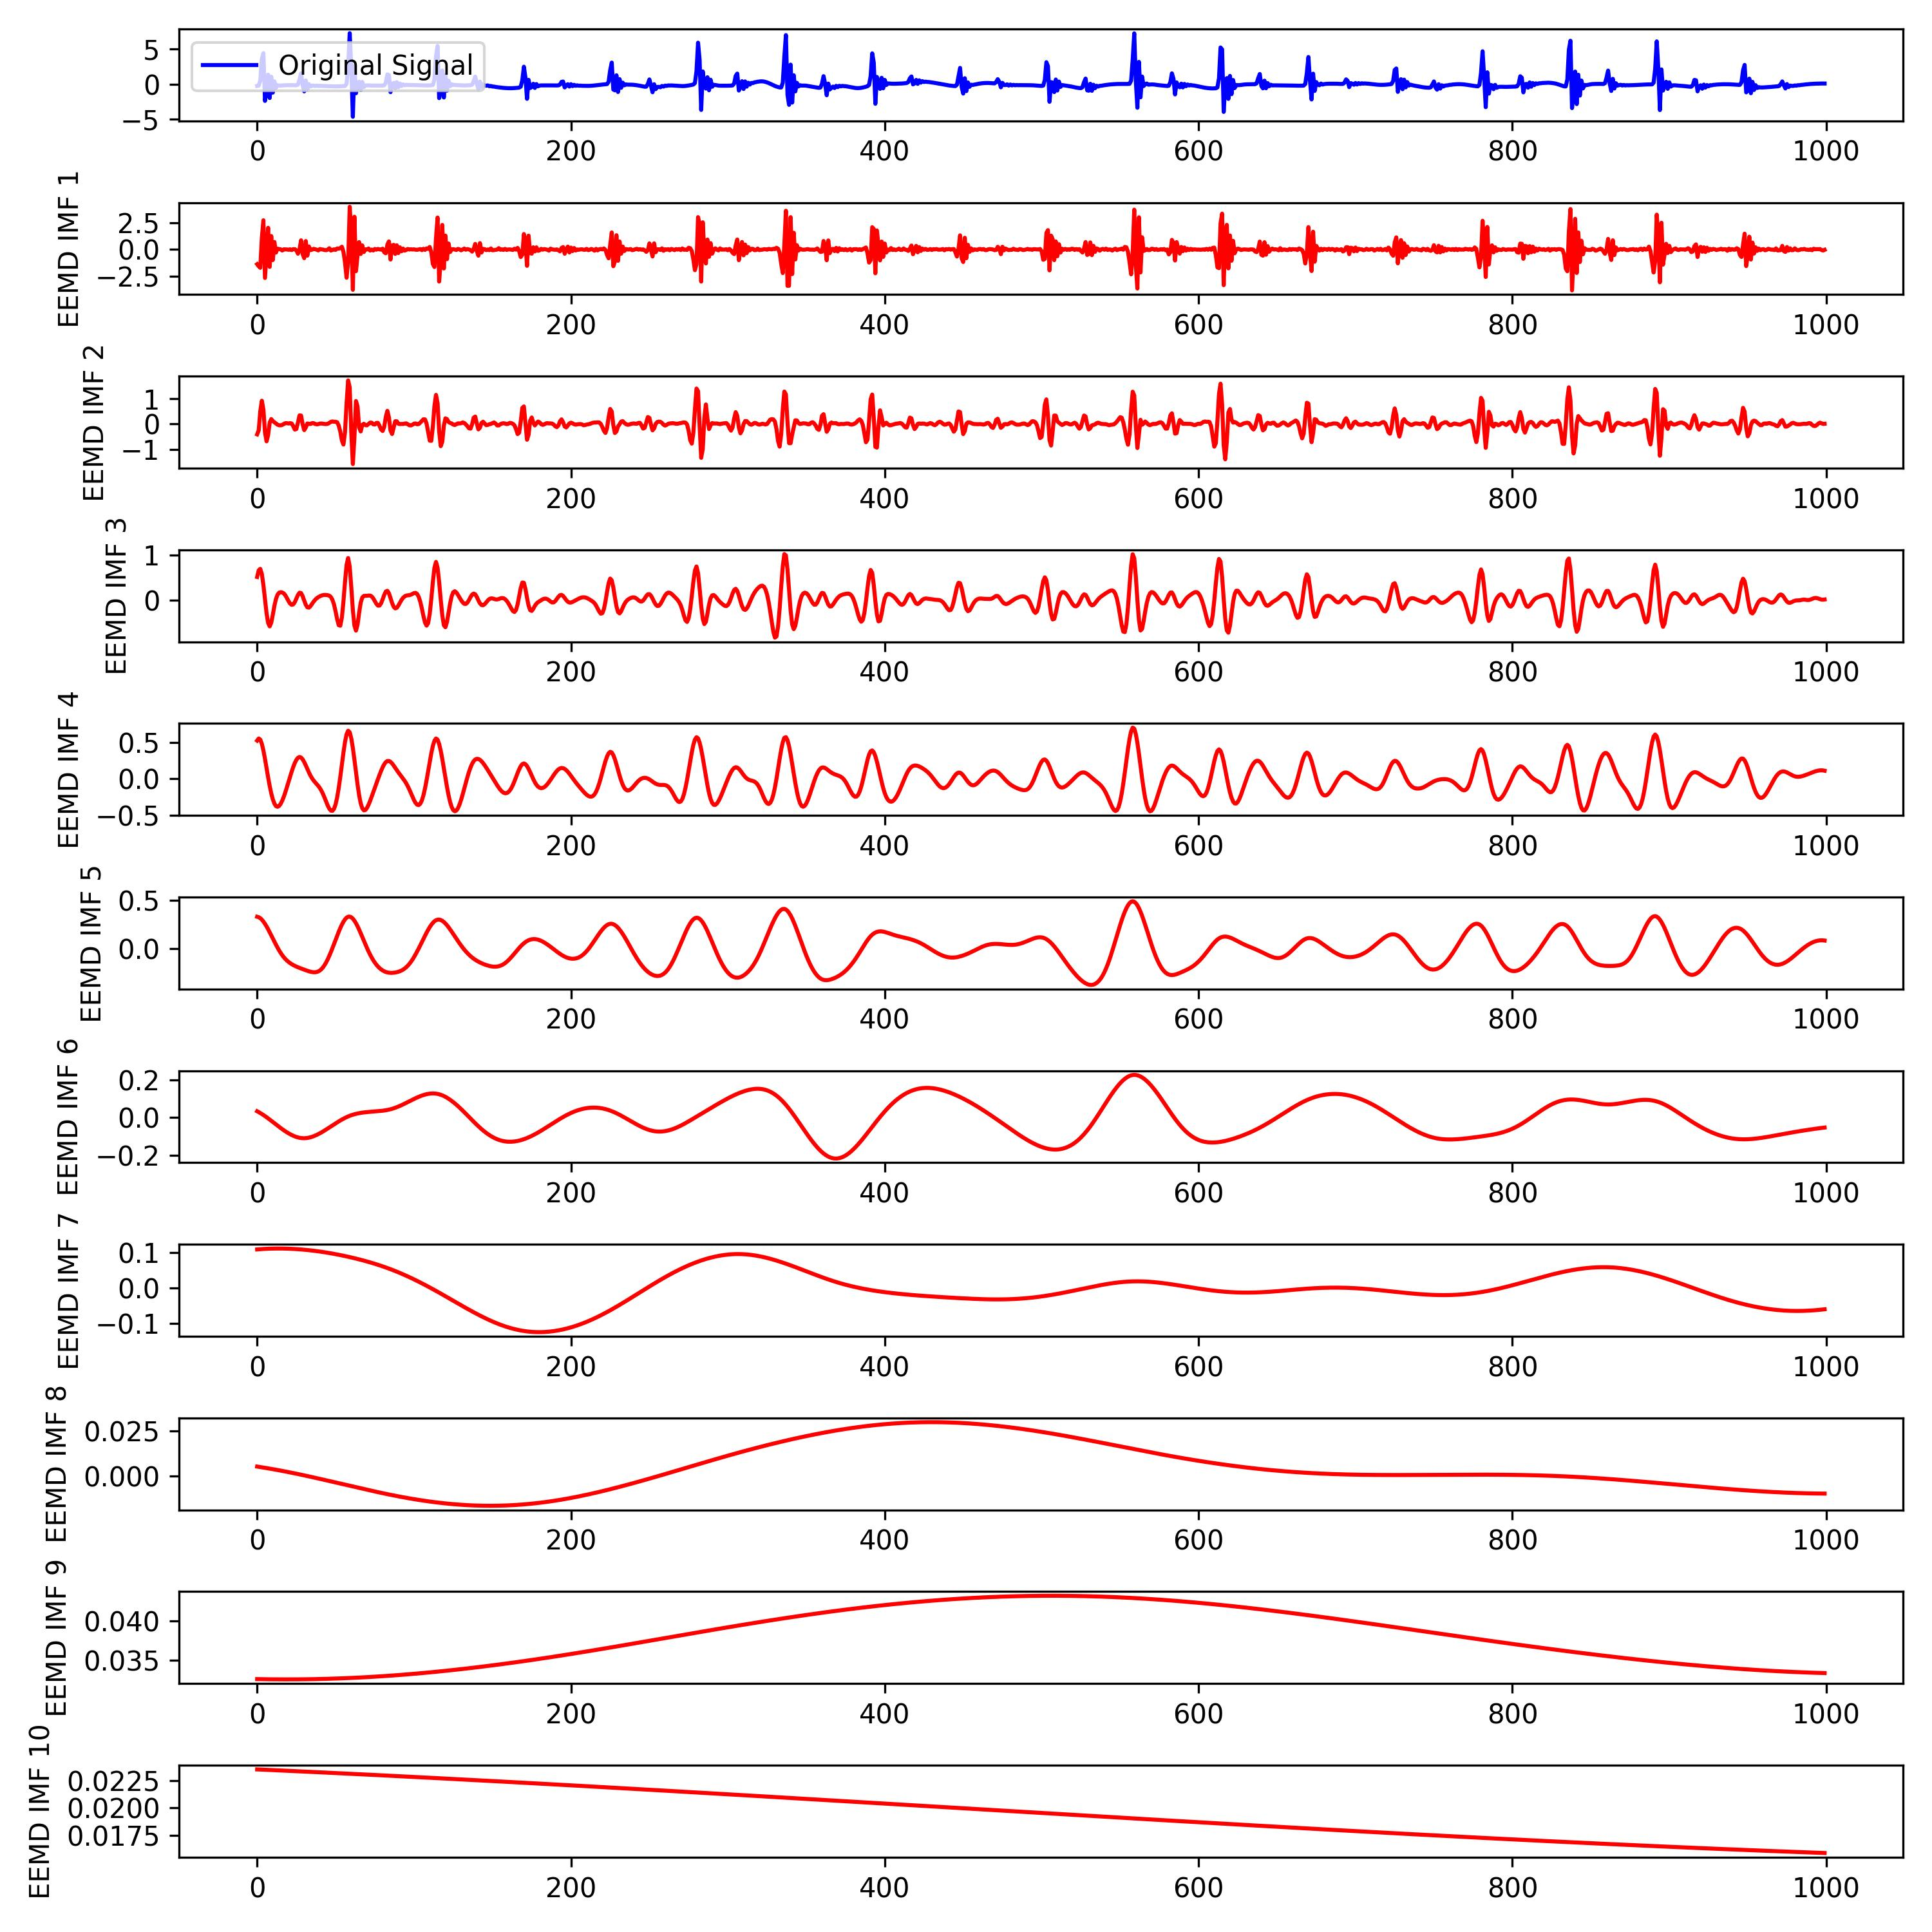
Work_3: Implement One Paper: Band Filter, EEMD, PCA and Spectrum Analysis
Band-pass filter: 0.1 Hz – 8 Hz
EMD and EEMD:
EMD
EEMD
From the perspective of IMF_1 and IMF_2, decomposition effect of EEMD is better.
Choose EEMD!
Notes:
Okay, let's go through it quickly.
The pass range of this band-pass filter is 0.1 Hz to 8 Hz.
Let's take a look at the decomposition effects of EMD and EEMD on the same segment of the signal.
From the perspective of IMF_1 and IMF_2, decomposition effect of EEMD is better.
Choose EEMD!

Slide 7
Work_3: Implement One Paper: Band Filter, EEMD, PCA and Spectrum Analysis
Selection of IMFs:
Fusion of IMFs:
Strategy 1: Using only PCA.
Strategy 2: When only one IMF is selected, PCA is not used. The selected IMF is used directly.
Strategy 3: Not using PCA, directly summing up the IMFs.
0.75 Hz < IMFs < 2.25 Hz
Group1: HR Estimation
Num of IMFs in Group1 ranges from 1 to 4
0.1 Hz < IMFs < 0.75 Hz
Group2: RR Estimation
Num of IMFs in Group2 ranges from 1 to 2
The limited number of IMFs makes it difficult for PCA to leverage its advantages, and it might even lead to significant errors!!!
Notes:
Next step is the selection of IMFs
IMFs with frequencies between 0.75 Hz and 2.25 Hz are assigned to the first group for estimating HR.
Num of IMFs in Group1 ranges from 1 to 4
IMFs with frequencies between 0.1 Hz and 0.75 Hz are assigned to the second group for estimating RR.
Num of IMFs in Group2 ranges from 1 to 2
The limited number of IMFs makes it difficult for PCA to leverage its advantages, and it might even lead to significant errors!!!
AS to the fusion of IMFs, I tried three different strategies.
Strategy 1 is Using only PCA.
Strategy 2 is When only one IMF is selected, PCA is not used. The selected IMF is used directly.
Strategy 3 is Not using PCA, directly summing up the IMFs.

Slide 8
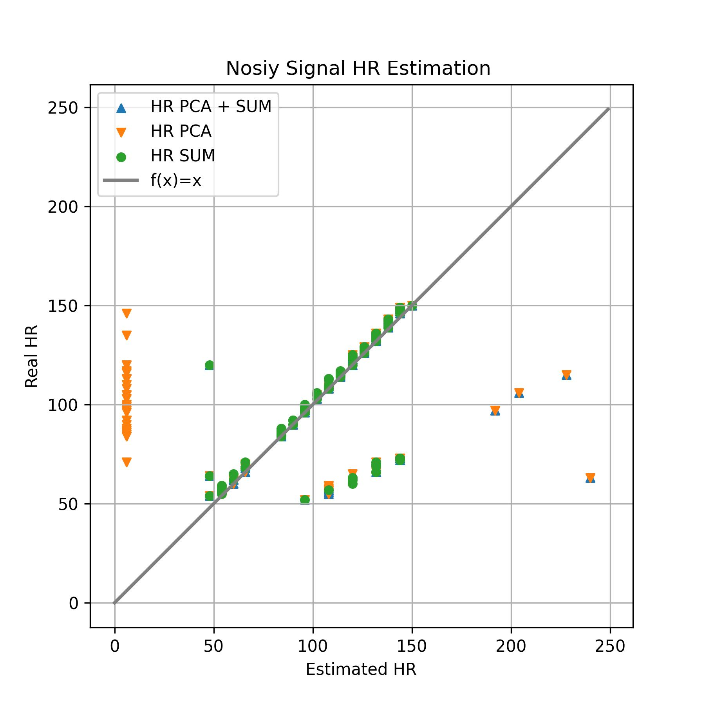
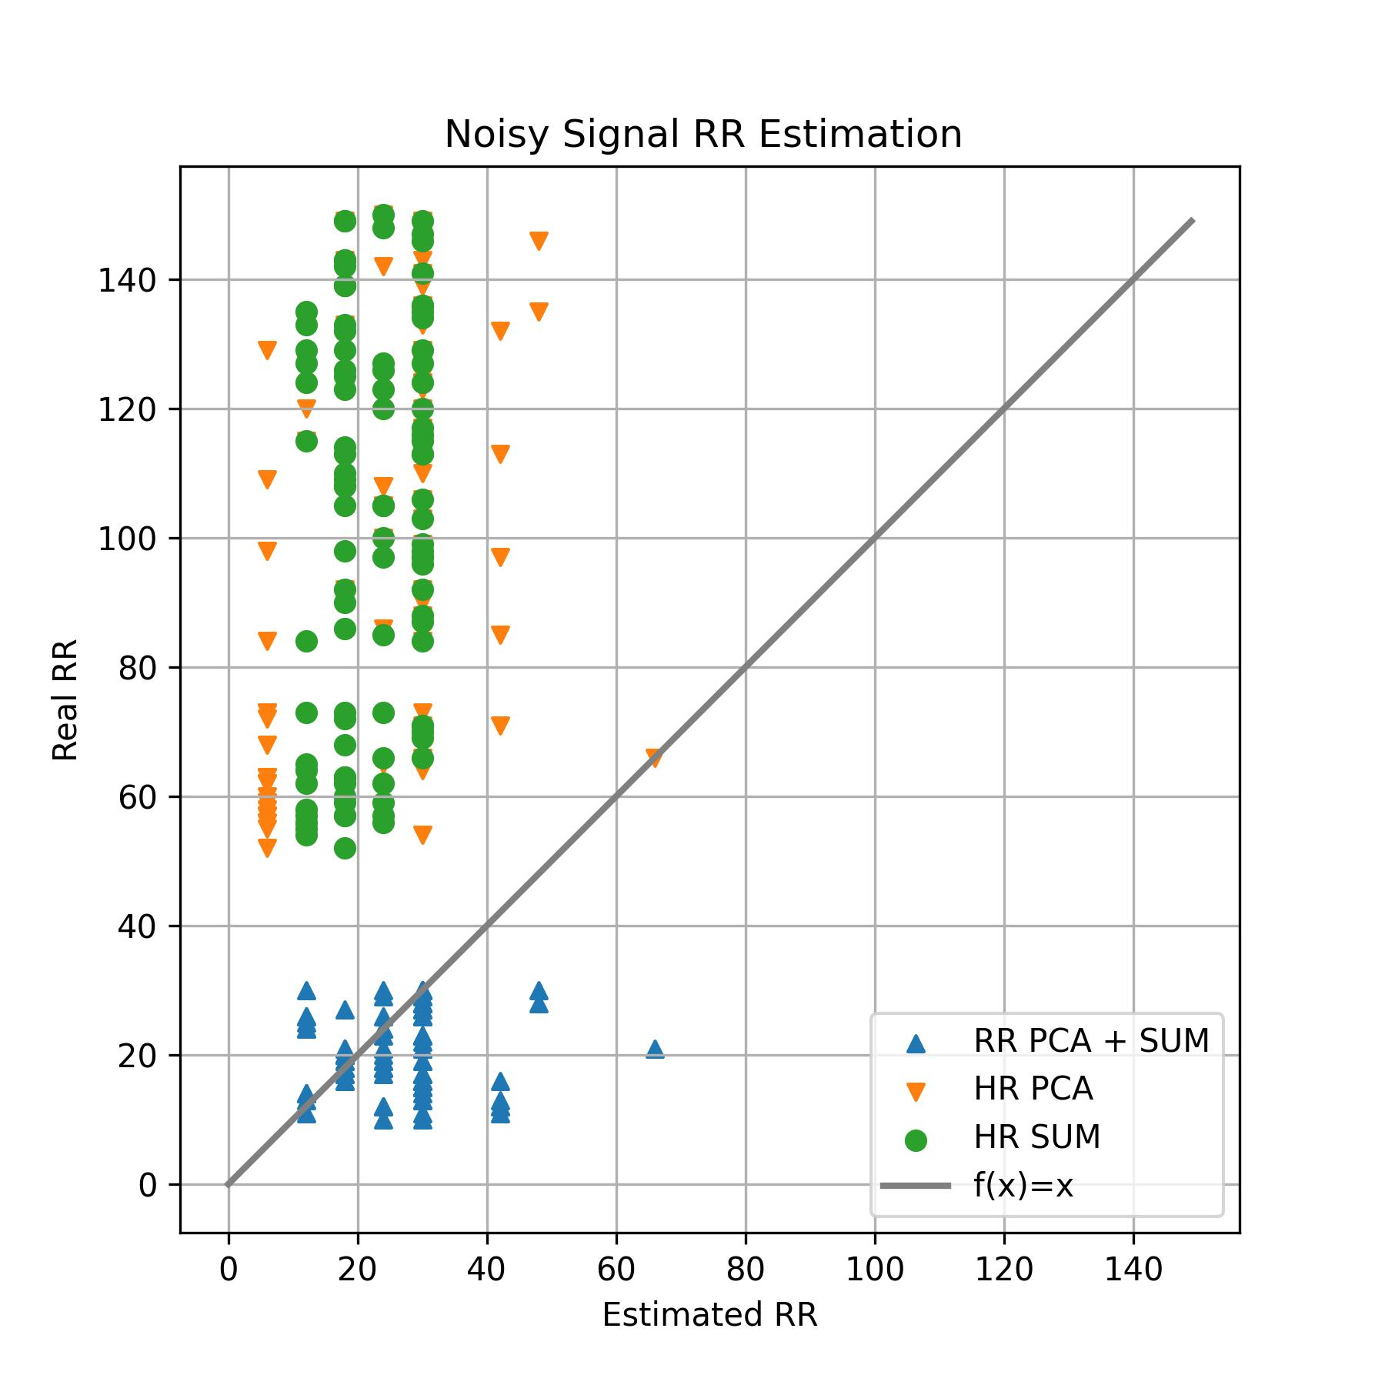
Work_3: Implement One Paper: Band Filter, EEMD, PCA and Spectrum Analysis
Conclusions:
In HR estimation, directly summing up IMFs is better, as strategies involving PCA tend to have more outliers.
In RR estimation, 3 strategies have awful performance. This is due to the lack of careful signal denoising (only band-pass filter).
HR ranging from
[50, 150]
RR ranging from
[10, 30]
Notes:
Ok, let look at the result.
Here is the result of Noisy signals.
The two black boxes in the graph represent the ranges for HR and RR, respectively.
We can get 2 conclusions.

Slide 9
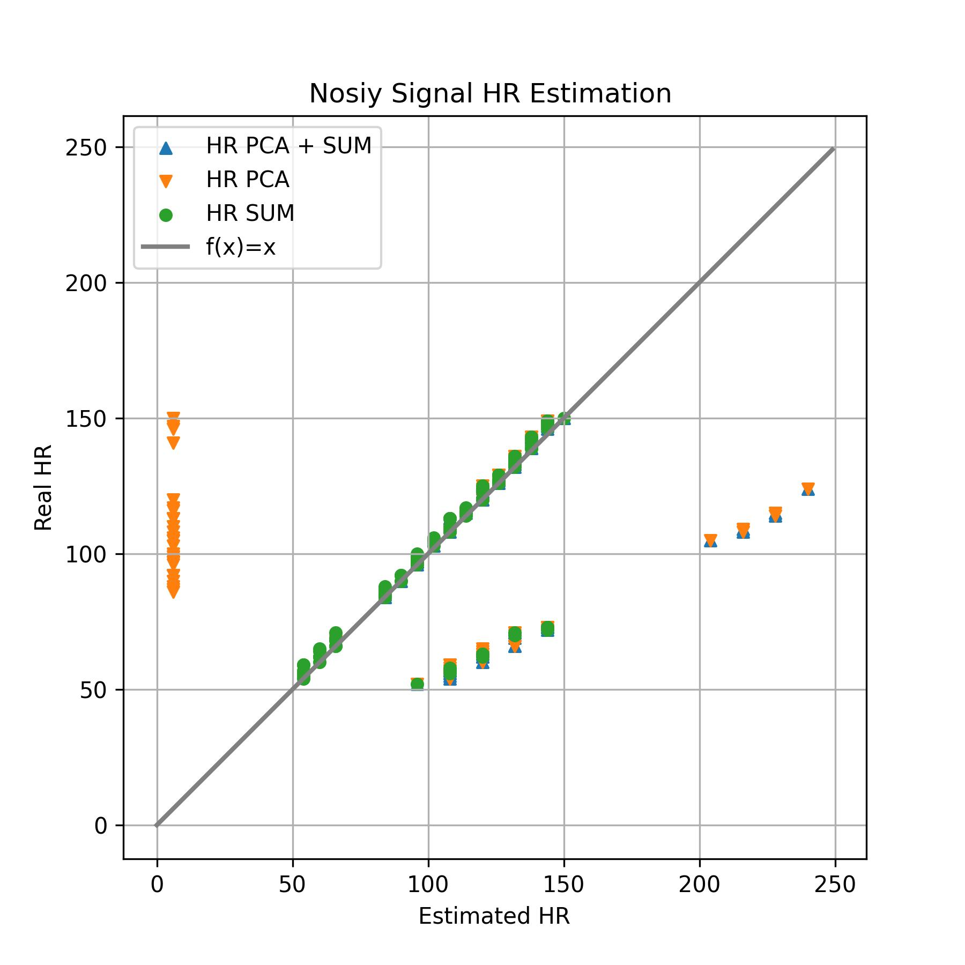
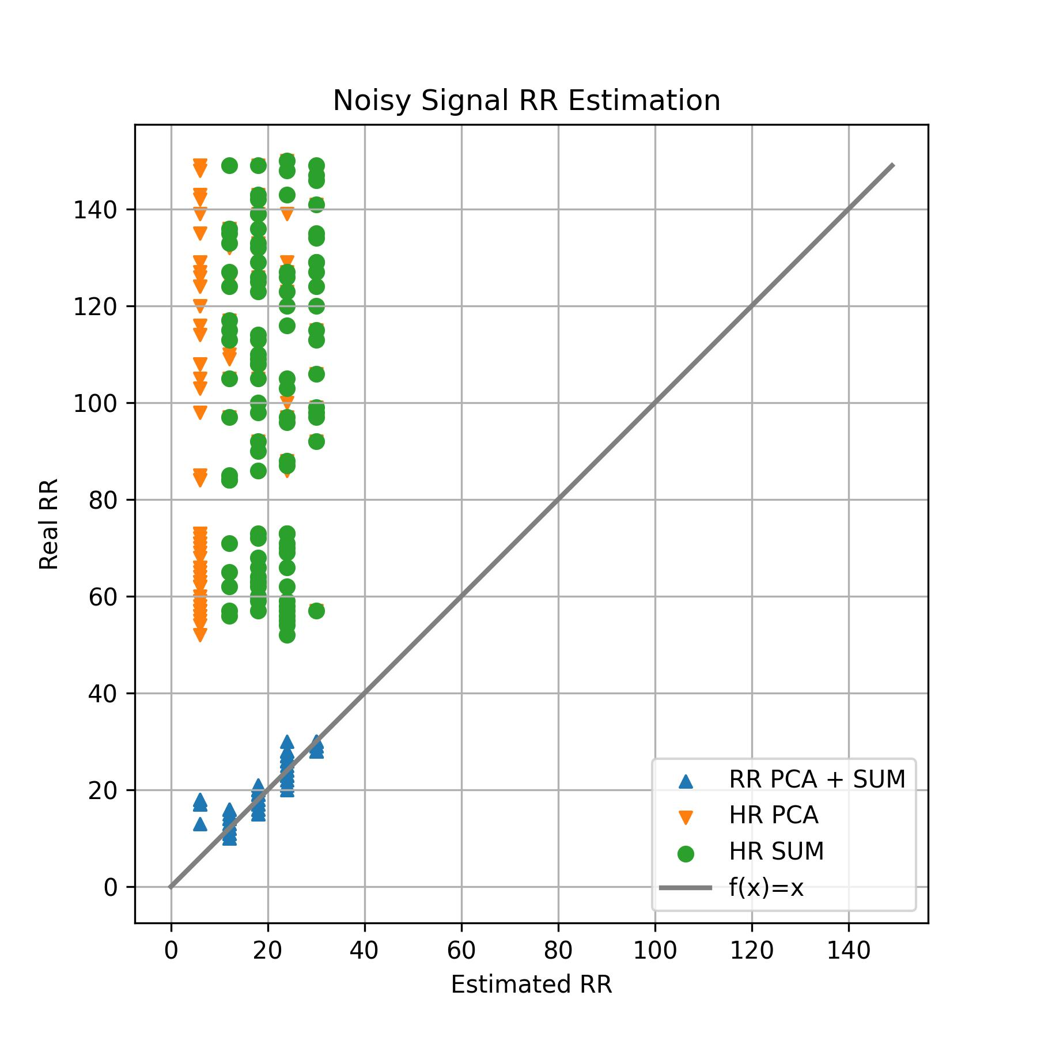
Work_3: Implement One Paper: Band Filter, EEMD, PCA and Spectrum Analysis
Conclusions:
After denoising, the performance of HR and RR estimation has significantly improved.
In HR estimation, summing up IMFs shows best results.
In RR estimation, (PCA+SUM) shows best results.
Clean Signal HR Estimation
Clean Signal RR Estimation
HR ranging from
[50, 150]
RR ranging from
[10, 30]
Two possible reasons of the inability to achieve the same performance as mentioned in the paper:
1. The original paper used ECG signals rather than SCG signals.
2. The selection of IMFs may differ from the implementation in the original paper.
Notes:
Here is the result of clean signals.
From these 2 graphs, we can get 3 conclusion:
2. 3.
If use clean signal, this algo seems to work adequately.
Here are Two possible reasons of the inability to achieve the same performance as mentioned in the paper:
1. The original paper used ECG signals rather than SCG signals.
2. The selection of IMFs may differ from the implementation in the original paper.

Slide 10
Work_4: Clustering Exploration
2个想法：
对原始信号的片段直接聚类，他们的某些指标会不会也随之聚类。
能否通过对原始信号的片段直接聚类，帮助我们提升HR，RR估计的精度？
我对原始信号直接聚类，得出了5个结论。
Notes:
2个想法：
对原始信号的片段直接聚类，他们的某些指标会不会也随之聚类。
能否通过对原始信号的片段聚类，帮助我们提升某些指标估计的精度？
所以，我对此展开了实验，得出了5个结论

Slide 11
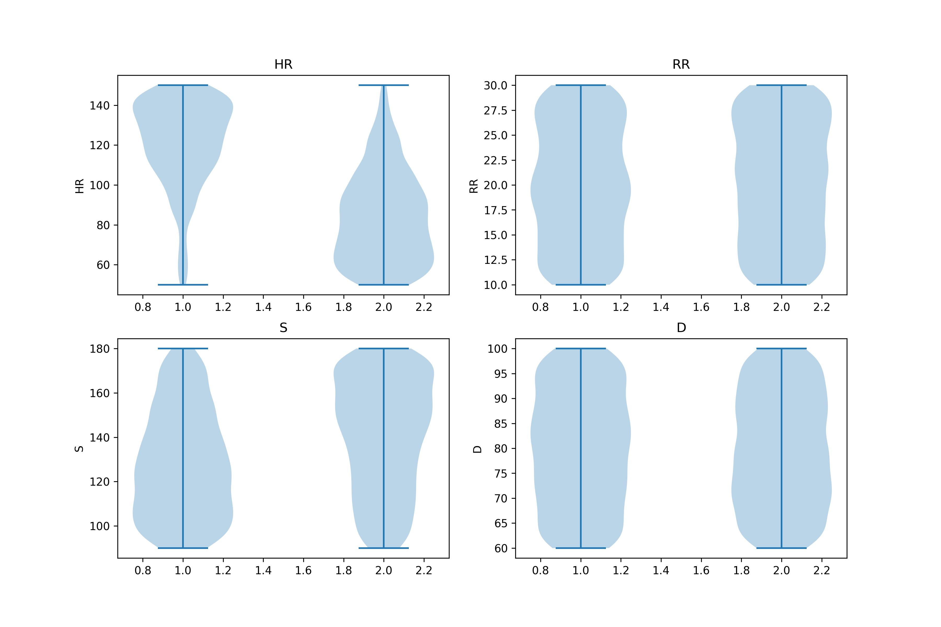
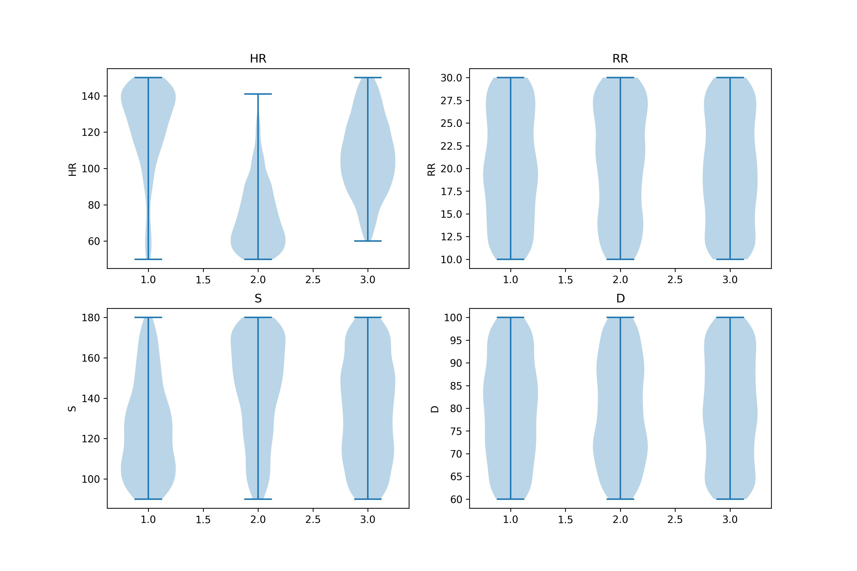
Work_4: Clustering Exploration
Conclusion 1:对HR有较为明显的分类作用， 对S有轻微的分类，对其余两个指标完全没意义
Notes:
2个想法：
对原始信号的片段直接聚类，他们的某些指标会不会也随之聚类。
能否通过对原始信号的片段聚类，帮助我们提升某些指标估计的精度？
所以，我对此展开了实验，得出了5个结论

Slide 12
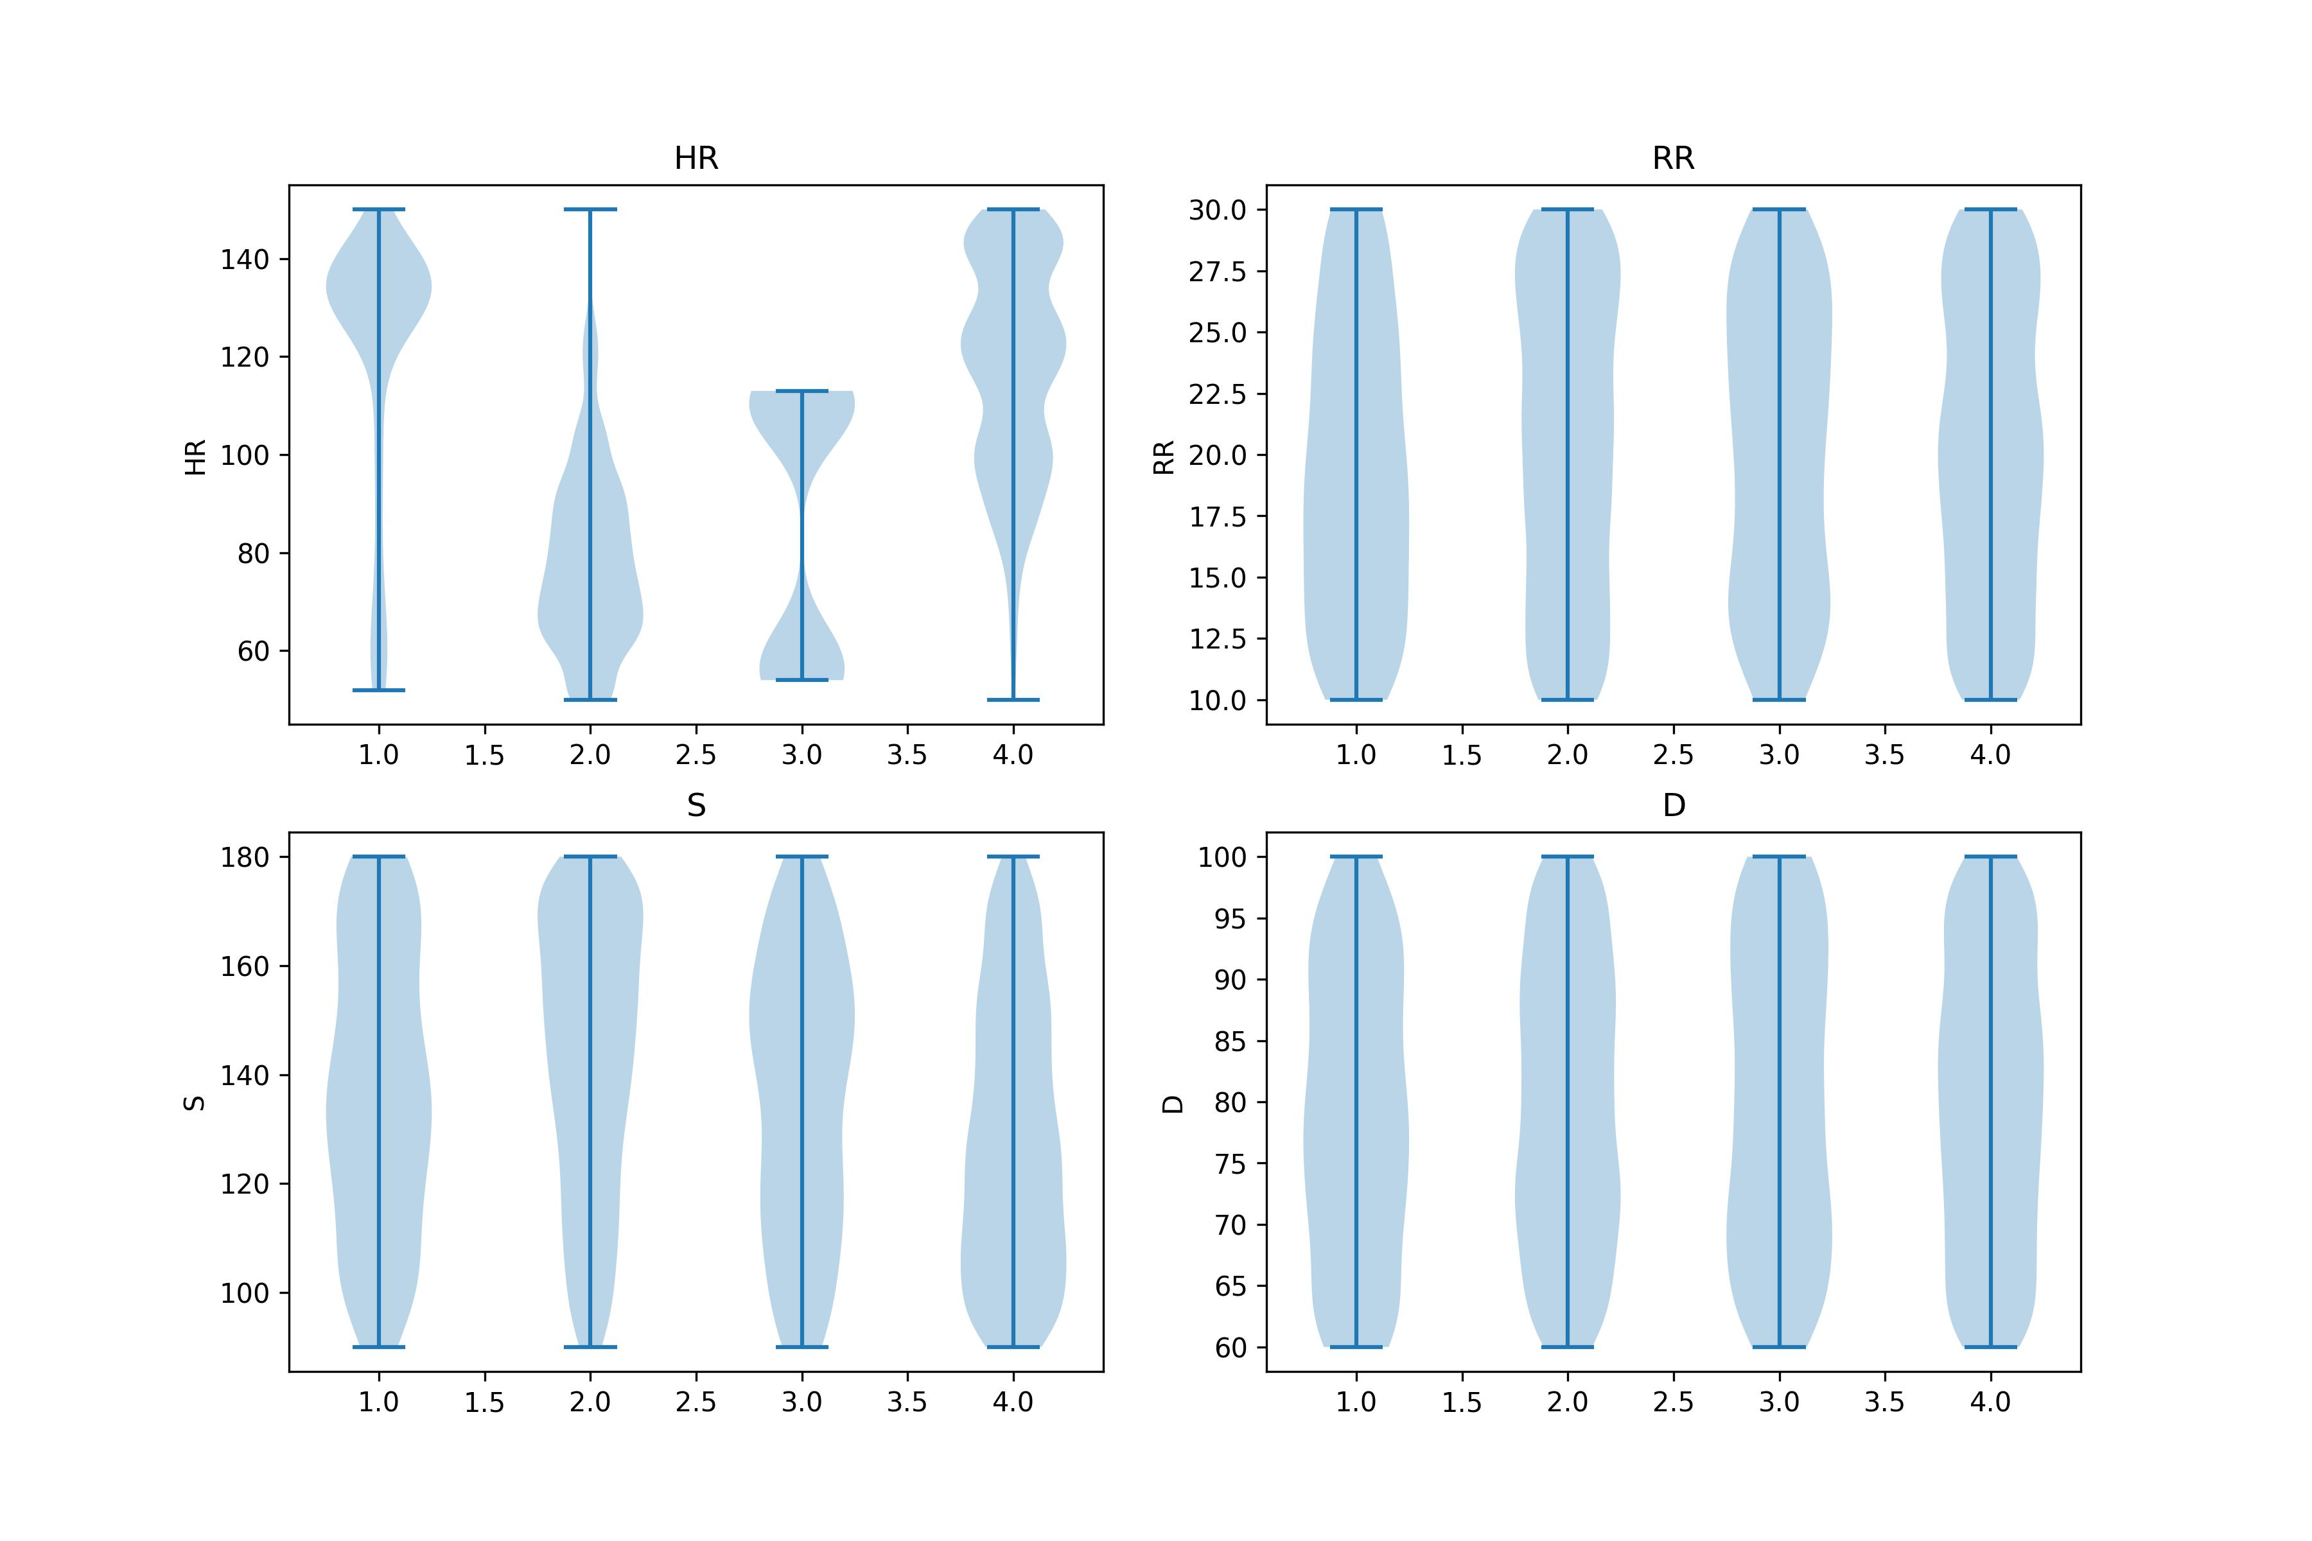
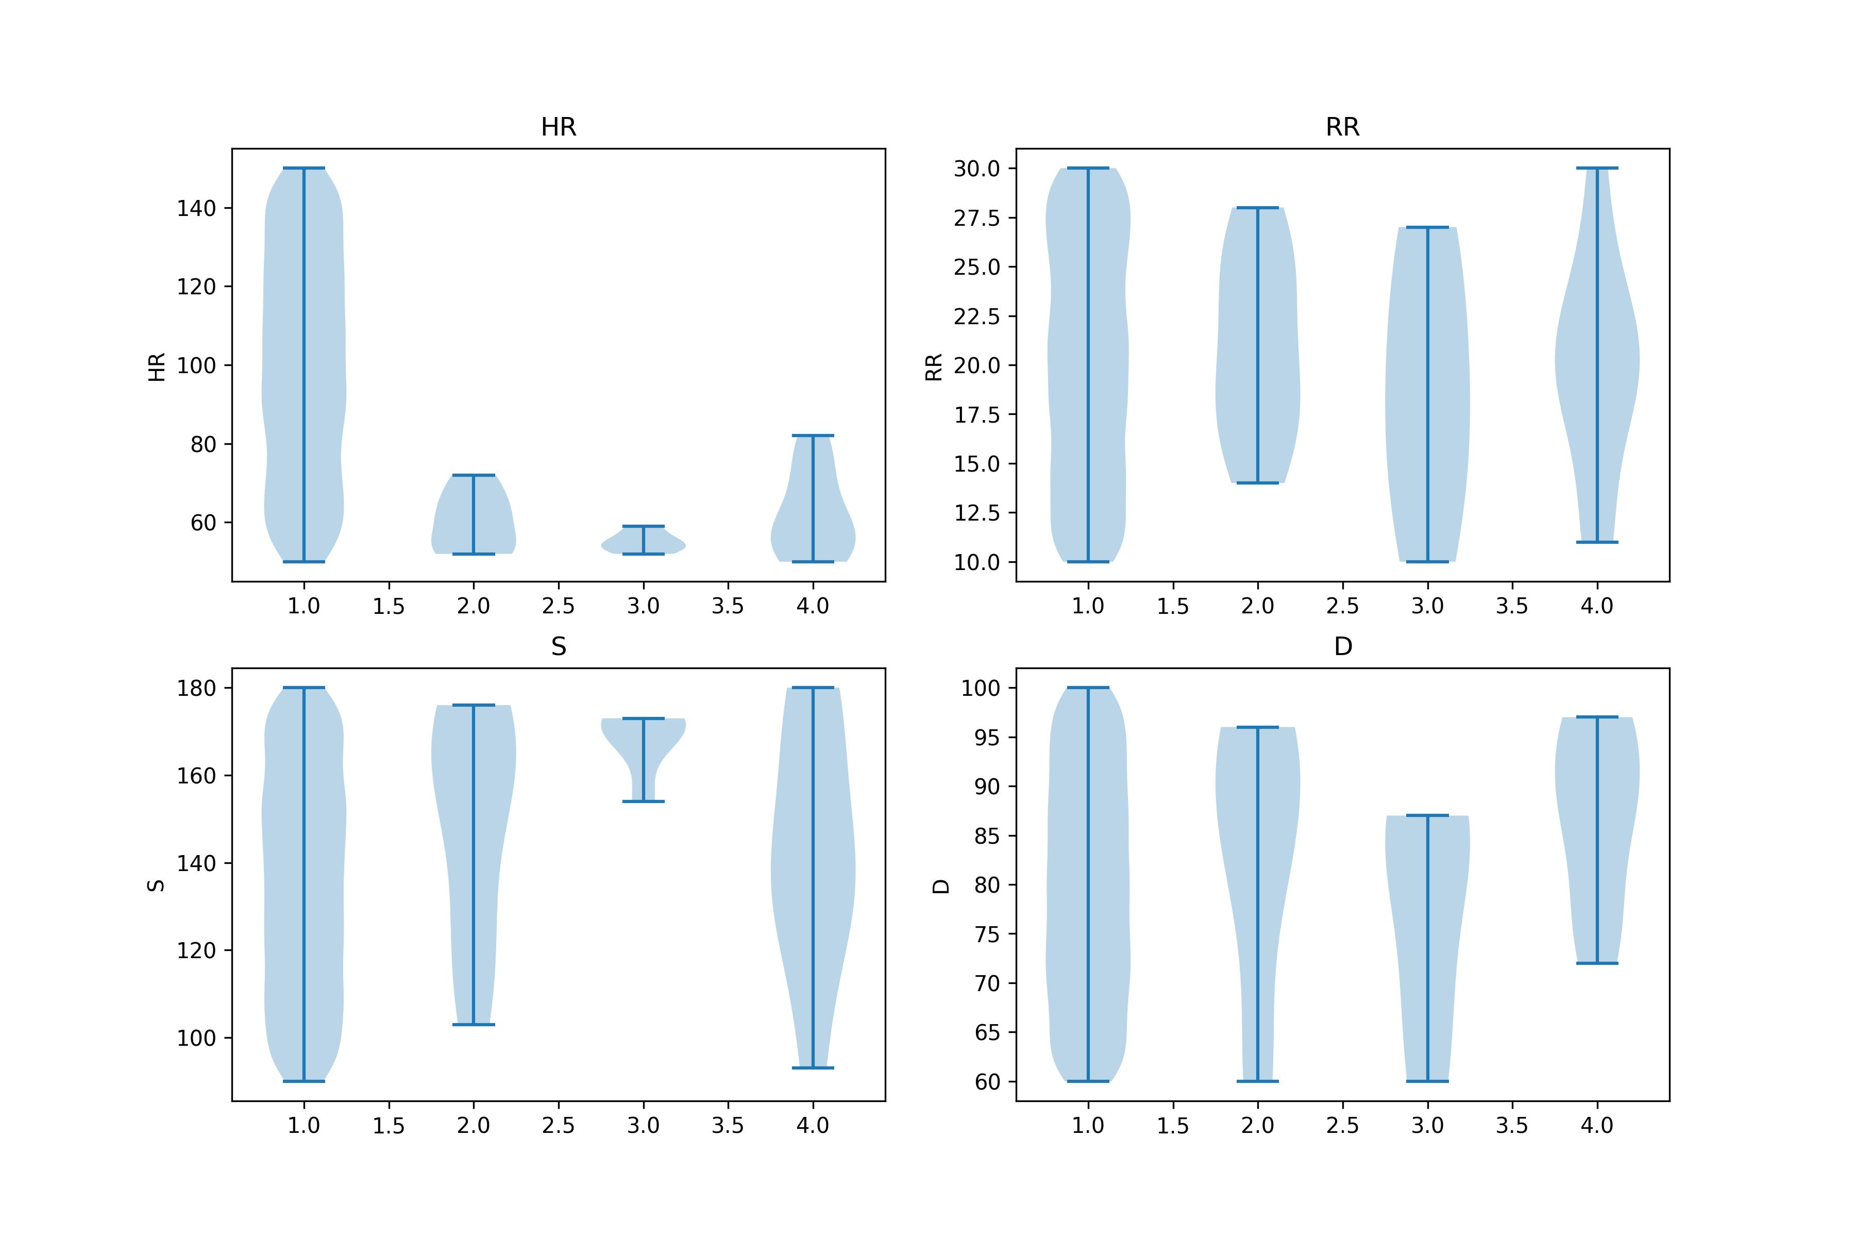
Work_4: Clustering Exploration
Conclusion 2: 聚类>3时，没有意义
K-Shapes, Noisy signals
K-Means, Noisy signals
Notes:
2个想法：
对原始信号的片段直接聚类，他们的某些指标会不会也随之聚类。
能否通过对原始信号的片段聚类，帮助我们提升某些指标估计的精度？
所以，我对此展开了实验，得出了5个结论

Slide 13
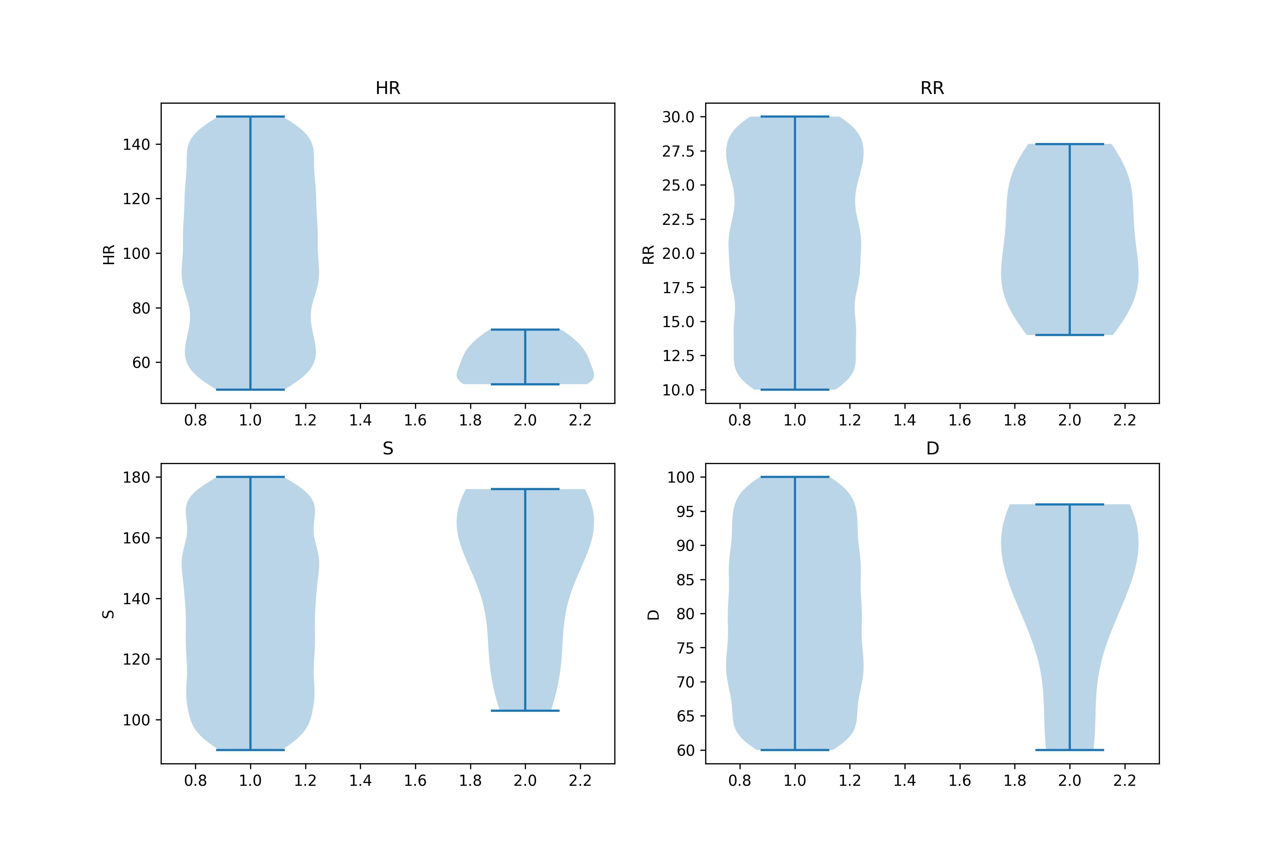
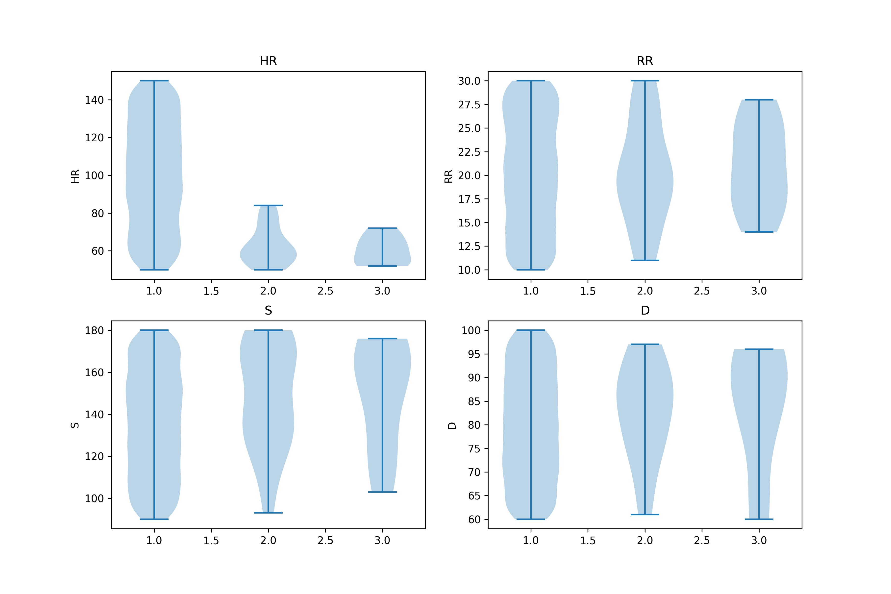
Work_4: Clustering Exploration
Conclusion 3: K-shapes >> K-Means
K-Shapes, Noisy signals
K-Means, Noisy signals
K-Shapes, Noisy signals
K-Means, Noisy signals

Slide 14
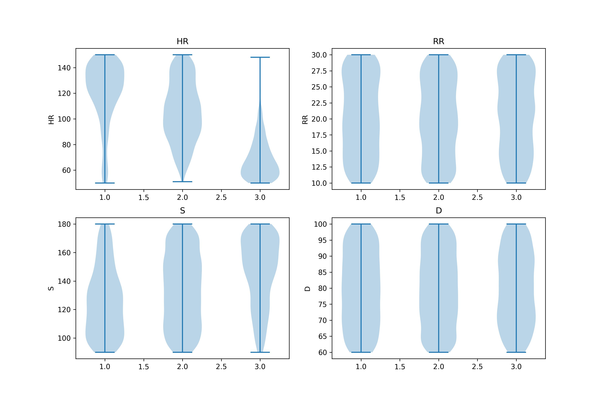
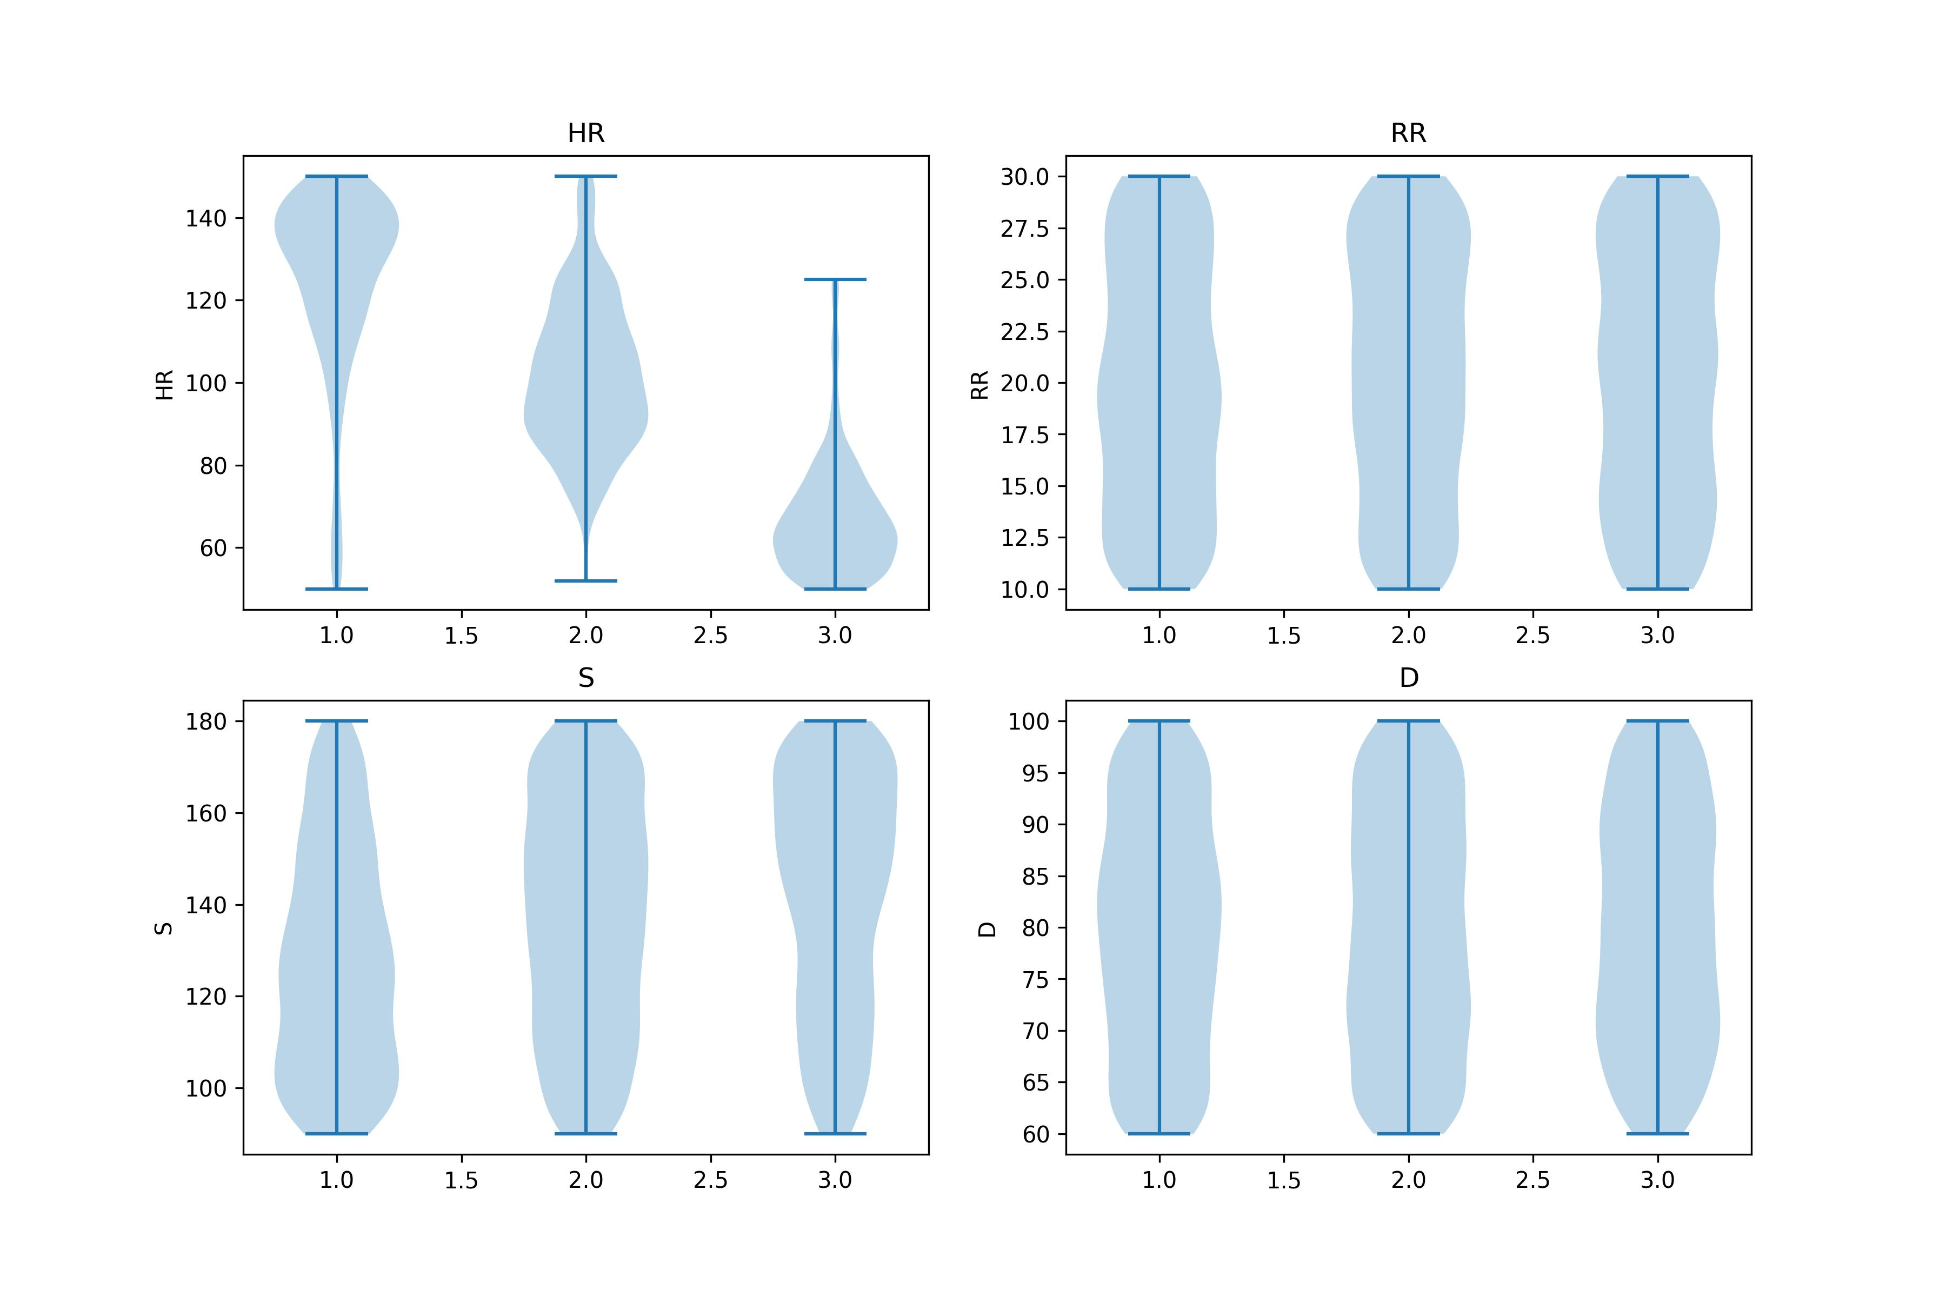
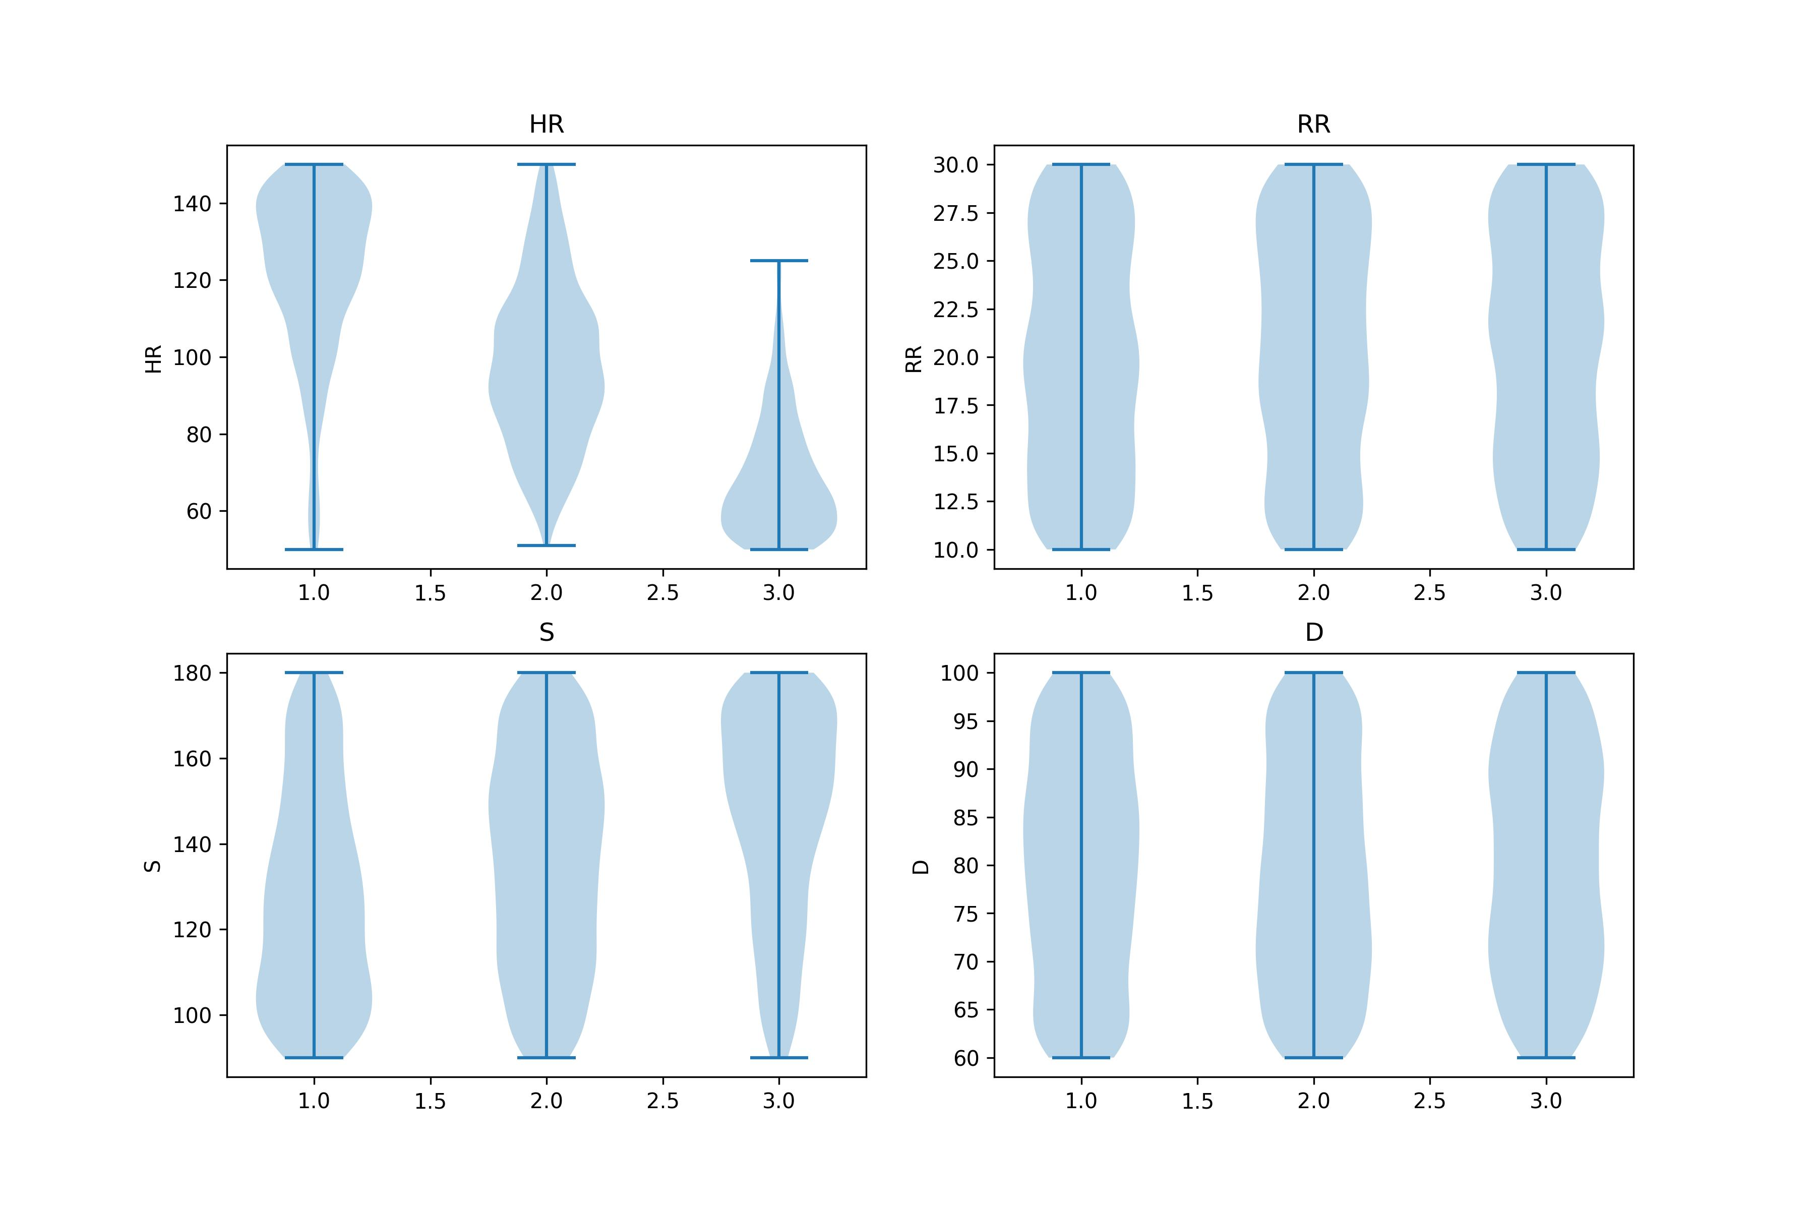
Work_4: Clustering Exploration
Conclusion 4: 对截取信号的长度不是很敏感，但不宜过长和过短。
K-Shapes, 300ms
K-Shapes, 600ms
K-Shapes, 1200ms
K-Shapes, 2400ms
所截取信号片段长度与HR指标的聚类效果（主观）
效果
0.3
0.6
1.2
2.4
Second
Notes:
2个想法：
对原始信号的片段直接聚类，他们的某些指标会不会也随之聚类。
能否通过对原始信号的片段聚类，帮助我们提升某些指标估计的精度？
所以，我对此展开了实验，得出了5个结论

Slide 15
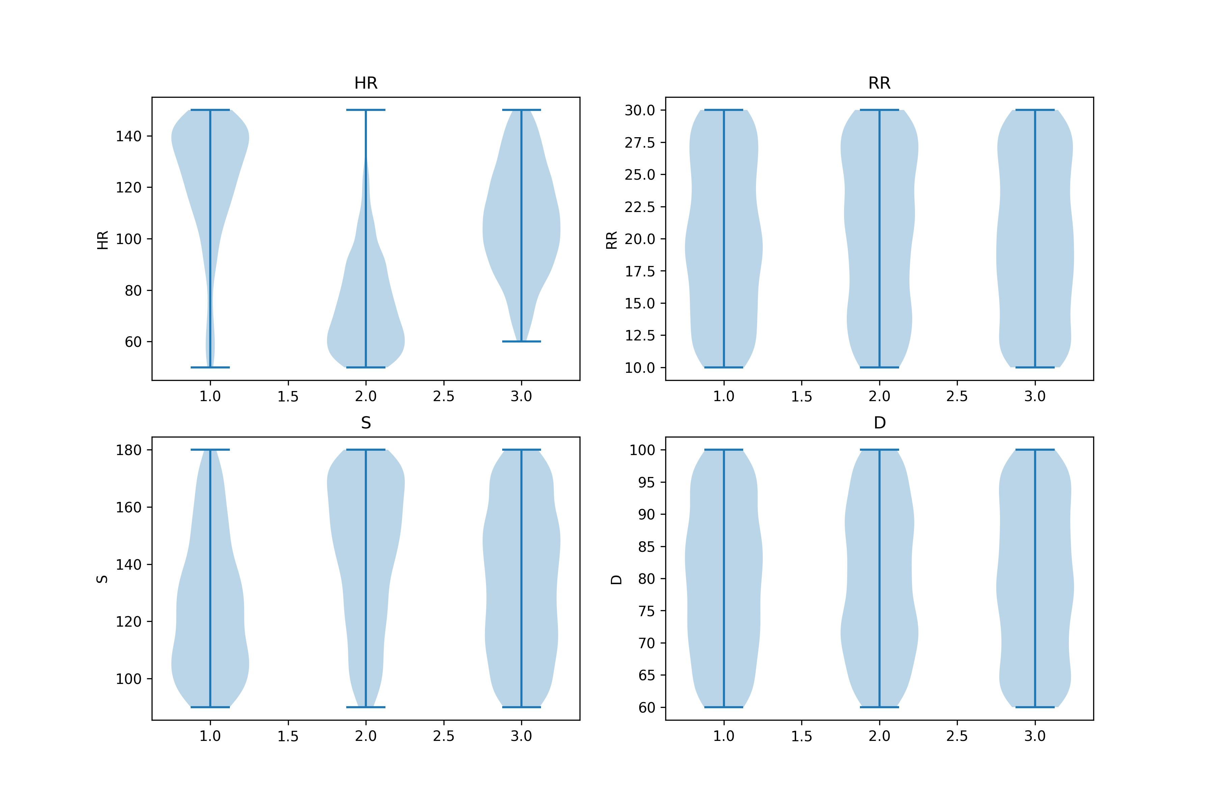
Work_4: Clustering Exploration
Conclusion 5: 对噪声不是很敏感
K-Shapes，120ms
I checked codes several times, the clustering results is the same, 不管是不是有这0.1dB nosie
Noisy
No Noise
Noisy
No Noise
Notes:
2个想法：
对原始信号的片段直接聚类，他们的某些指标会不会也随之聚类。
能否通过对原始信号的片段聚类，帮助我们提升某些指标估计的精度？
所以，我对此展开了实验，得出了5个结论

Slide 16
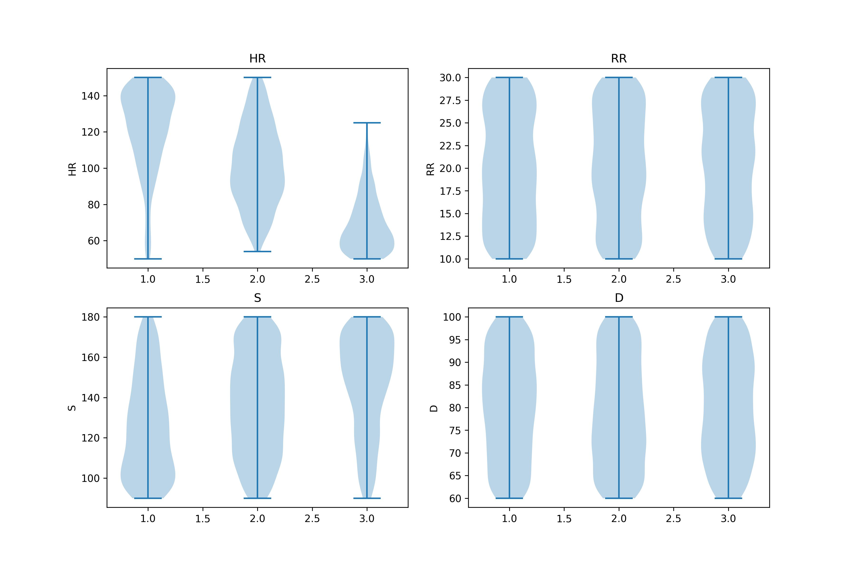
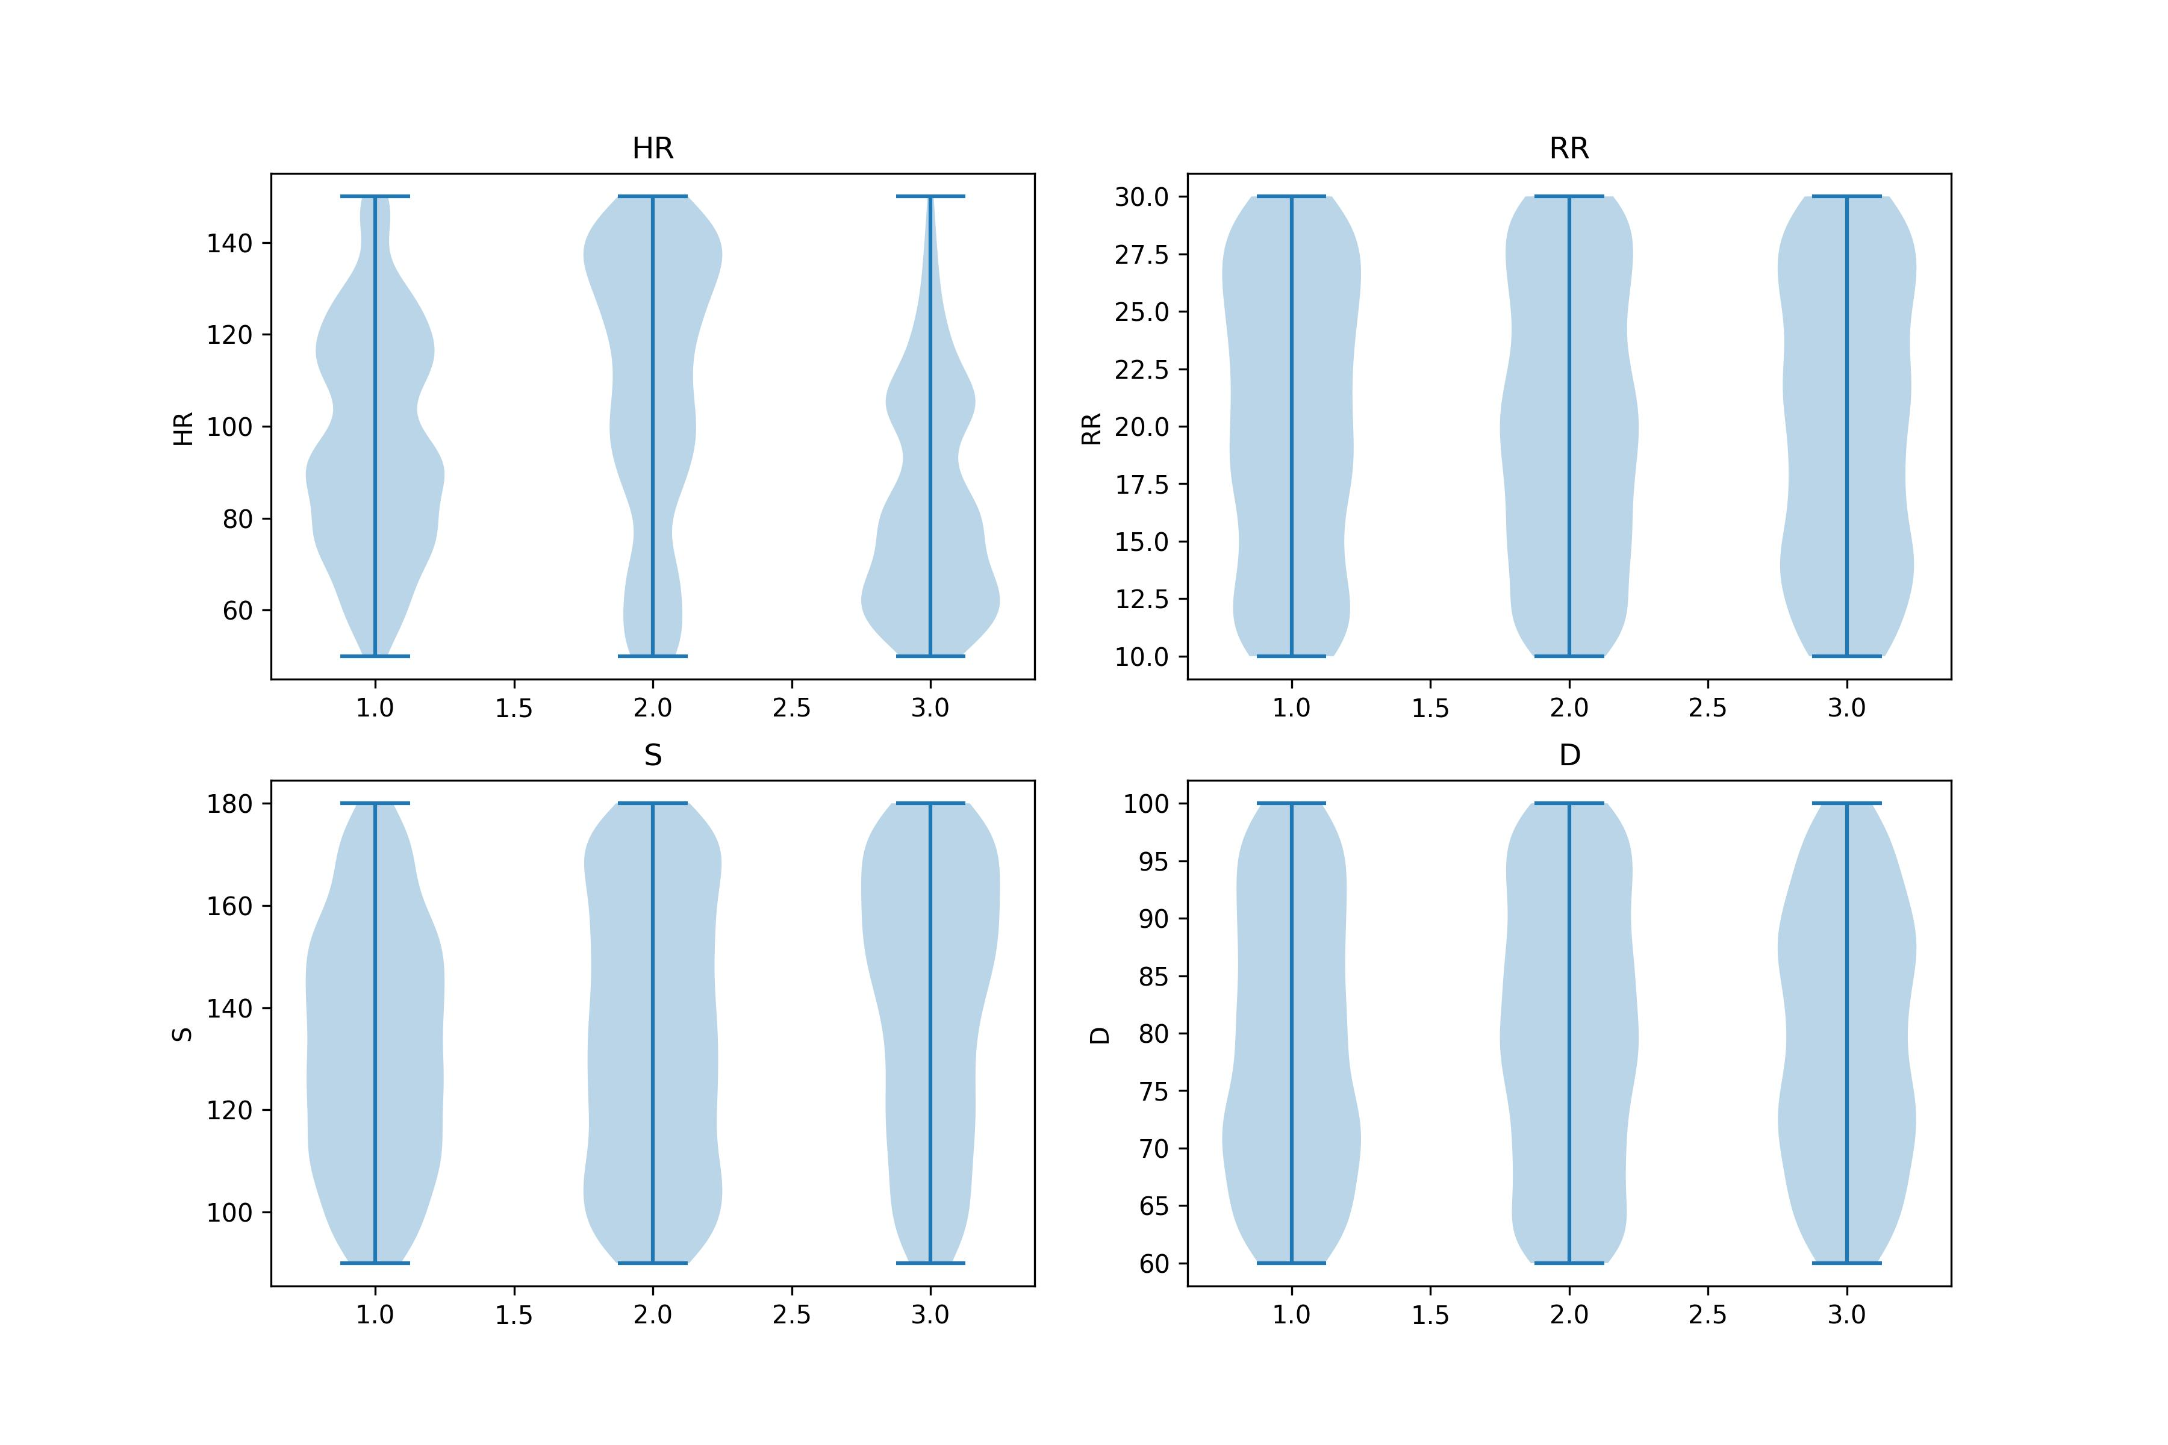
Work_4: Clustering Exploration
随后，我对之前得到的template也尝试了聚类
Conclusion1：对HR和S的聚类效果，提升不显著。对RR和D依然如此没有任何效果。
Conclusion2：K-shapes >> K-means
K-Shapes, Templates
K-Means, Templates
Notes:
2个想法：
对原始信号的片段直接聚类，他们的某些指标会不会也随之聚类。
能否通过对原始信号的片段聚类，帮助我们提升某些指标估计的精度？
所以，我对此展开了实验，得出了5个结论

Slide 17
Work_5: Tutorial
Features:
Statistical
Temporal
Spectral
Progress:
(8/8)
(11/15)
(15/20)
Now:
Input: 1-D signal (N, )
Next Step:
Input: 2-D signal (M, N)
Filter (Butter, Chebyshev, Bessel)
EMD & EEMD
Denoising(FFT & Wavelet)
Clustering(K-Means, K-Shapes, Hierarchical clustering )
Notes:
Tutorial is divided into two parts,
the first part is the extraction of common features in signal processing.
It includes statistical features, Temporal features, and Spectral features.
Right now these functions only support one-dimensional data inputs,
the next step is to try to use matrix calculations to make them run two-dimensional inputs
The second part, which is a tutorial of commonly used algorithms,
includes three common filters, EEMD EMD

Slide 18
Work_6: Theoretical knowledge Learning
Signals and Systems
Application Materials
Course: EE120, Berkeley
This week's progress:
Lecture 8 (discrete-time Fourier transform)
Lecture 9 (discrete-time Fourier transform, continued)
Finish 1 lab
Next week’s plan:
Lecture 10 (the DFT; FIR filters)
Lecture 11 (Fourier transforms in two dimensions)
Finish 1 lab
This week's progress:
Statement of Purpose: 100 %
Writing Sample: 100 %
Today: Submit

Slide 19
Questions
How can I alone judge whether a method works or not, when I don't clearly understand its principles. For example, use the Hilbert transform to extract the envelope. I failed last time and then after your guidance succeeded this time.
The S is weakly responsive to clustering. Is it possible use clustering to divide S into several large ranges?

Slide 20

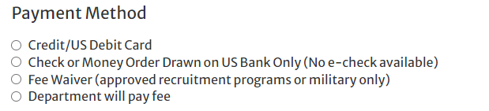
Questions About Application

Slide 21
Thanks!

